Slide 1
The Atomic Age
Goal: I will be able to understand the beginnings of the atomic age.

Slide 2
FDR receives a letter from Albert Einstein
Informed FDR of recent developments in splitting uranium atoms
Could lead to “extremely powerful bombs of a new type” by means of nuclear fission
Nucleus absorbs a neutron, breaks into two equal fragments
Certain elements release other neutrons which break up more atoms, creates a chain reaction, releases large amounts of heat and radiation
Incredibly destructive

Slide 3
Fission Bomb
Notes:
The names of the two atomic bombs were “The Fat Man” and “The Little Boy.” The Little Boy bomb was a gun-type fission bomb (shown above). Gun-type bombs generate a nuclear explosion by firing one piece of fissile material into another of the same type. In this case, the material is uranium. The bomb is gun-like in that a small wedge of uranium is fired at a larger, target piece. Upon impact, the two pieces fuse together briefly, forming what is called a supercritical mass (a mass slightly greater than what is necessary to sustain a chain reaction). The rapid release of massive amounts of energy in a limited volume creates the explosion. In the Little Boy bomb, a mass of uranium about the size of a baseball produced an explosion as powerful as 20 kilotons of TNT. (Microsoft Encarta Encyclopedia.)
Picture from – “Fission Bomb” Microsoft Encarta Encyclopedia

Slide 4
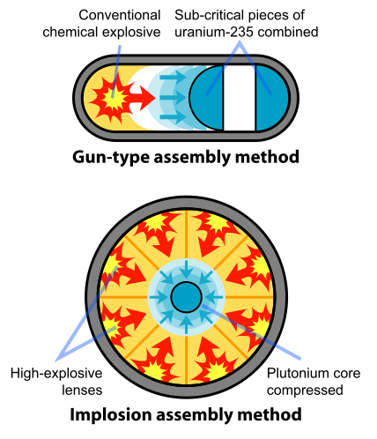

Slide 5
Einstein’s Letter
In the course of the last four months it has been made probable - through the work of Joliot in France as well as Fermi and Szilard in America - that it may become possible to set up a nuclear chain reaction in a large mass of uranium, by which vast amounts of power and large quantities of new radium-like elements would be generated. Now it appears almost certain that this could be achieved in the immediate future.
This new phenomenon would also lead to the construction of bombs, and it is conceivable - though much less certain - that extremely powerful bombs of a new type may thus be constructed. A single bomb of this type, carried by boat and exploded in a port, might very well destroy the whole port together with some of the surrounding territory. However, such bombs might very well prove to be too heavy for transportation by air...
Yours very truly,
(Albert Einstein)
Notes:
Einstein sent a letter to F.D.R. on August 1939 regarding the construction of an atomic bomb. The letter helped start the American atomic bomb project, but the United States did not immediately begin a crash program to build nuclear weapons. Leo Szilard was a Germany refugee physicist who discovered the nuclear chain reaction as a means of liberating atomic energy and creating an atomic bomb. Szilard worked for the Manhattan Project's Chicago laboratory. Einstein’s letter was taken seriously and America prepared itself for a top secret nuclear program.
PRIMARY SOURCE FROM - http://www.theenolagay.com/study.html#DECIDING%20TO%20BUILD%20THE%20BOMB

Slide 6
Manhattan Project
Concerned that Germany might develop similar technology and gain a huge military advantage, FDR gives permission for research to start
Manhattan Project was headed by Army Brigadier General Leslie Groves, who appointed physicist J. Robert Oppenheimer as scientific director
130,000 people working on project and cost more than $2 billion
Main research locations: Tennessee, Washington, and Los Alamos, New Mexico

Slide 7
Security of the Manhattan Project
Many workers had no idea what they were really working on
Some were not able to use telephones; others had to work under false names
Even despite the security measures, USSR sent spies
Klaus Fuchs, Theodore Hall, David Greenglass
Stalin aware of US technology
Allowed USSR to test its own bomb in 1949

Slide 8
Trinity Test
July 16, 1945, first atomic bomb was tested in New Mexico
Power surpassed the expectations of the scientists who had been working on it
Scientists realized that a single bomb could devastate an entire city and kill thousands of people

Slide 9
Notes:
The “Trinity” test was the first successful test of a nuclear weapon. The bomb tested an implosion-design plutonium bomb. This type of bomb was used in Nagasaki. The explosion was the equivalent of 20 kilotons of TNT. The test signified the beginning of the “atomic age.”
Betting pools were set up among the observers of “Trinity” on the results of the test. Some predictions ranged from zero, a dud, to 18 kilotons of TNT to destruction of the state of New Mexico to the ignition of the atmosphere and incineration of the planet.
This first nuclear explosion cast an ominous shadow over many, especially Oppenheimer. Robert Oppenheimer later said he thought of the lines from the Hindu scripture, the Bhagavad-Gita, "I am become Death, Destroyer of Worlds."
Picture - http://www.firstpulseprojects.com/trin2.jpg

Slide 10
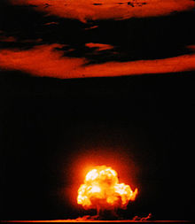

Slide 11
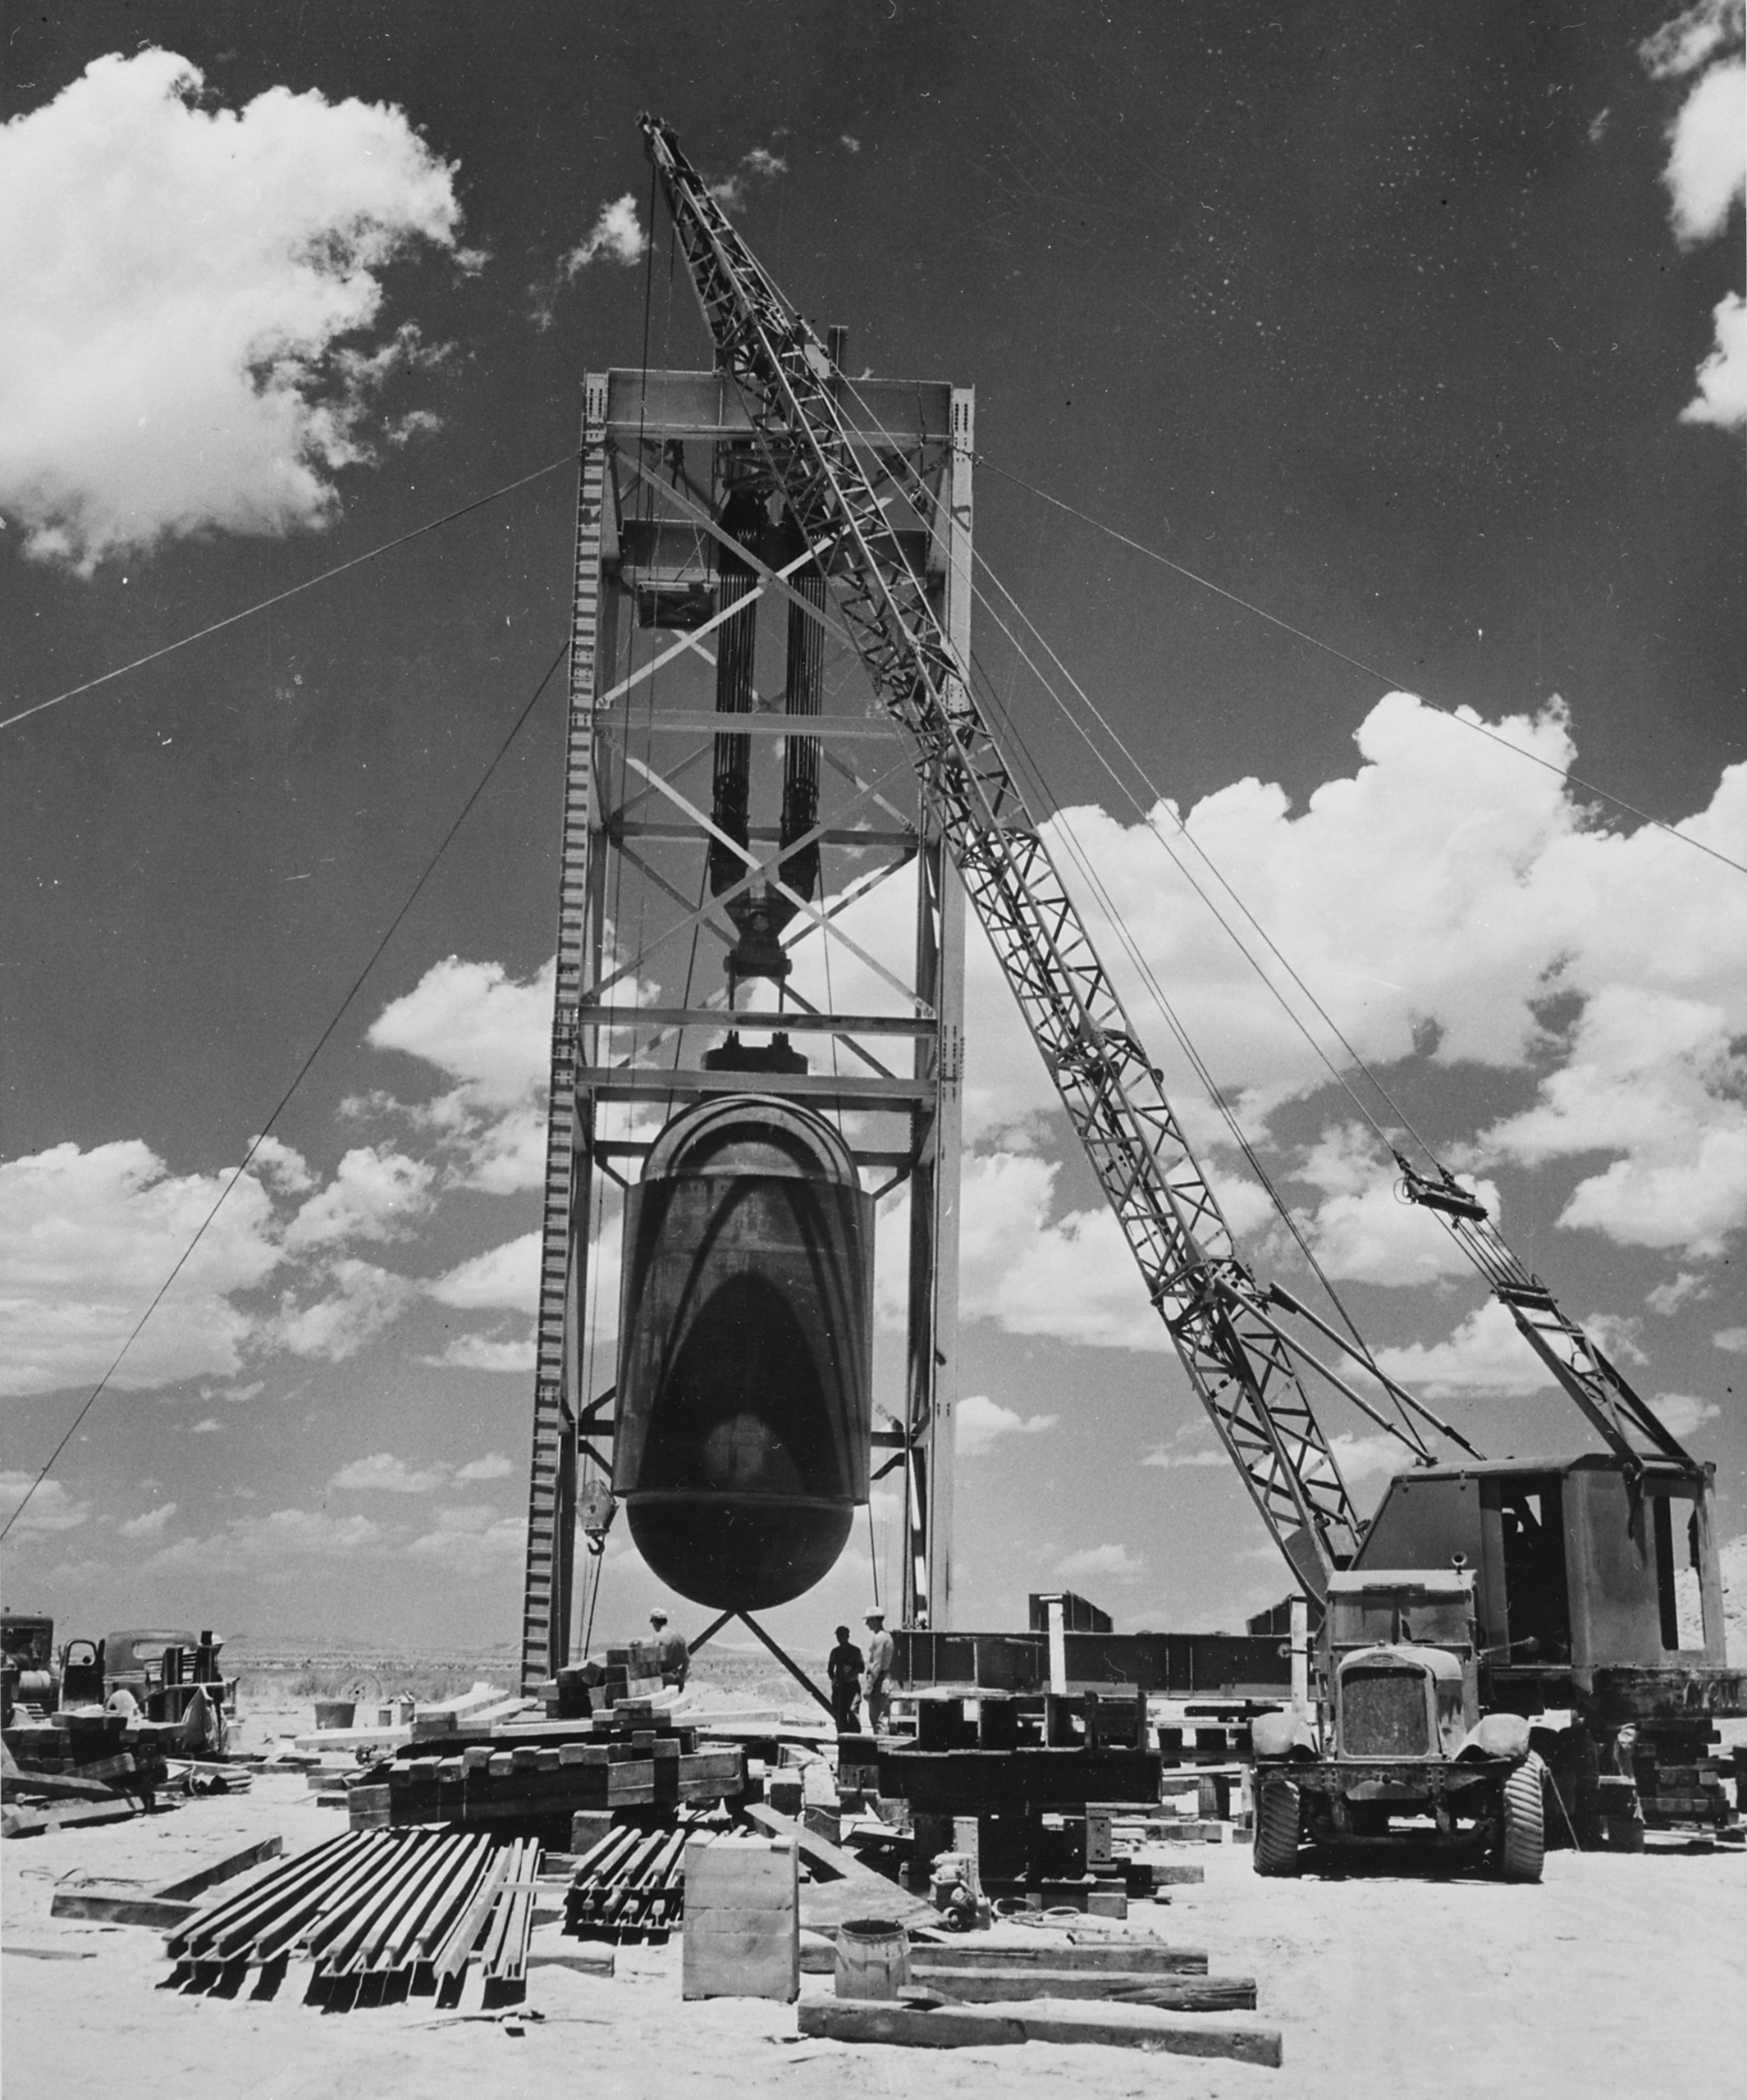

Slide 12
Trinity Test Equivalents
140 million degrees F
Initial explosion was brighter than the sun
bomb’s cloud rose at 5000 ft a minute
22,000 tons of conventional explosives
5,000 bombers would have been needed to deliver payload
Created a 1,200 ft crater in diameter, 25 ft deep
Light from explosion seen from 180 miles away

Slide 13
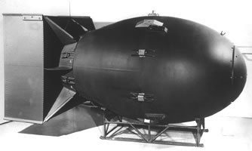
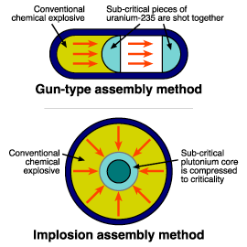
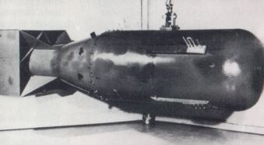
Fat Man and Little Boy
“Fat Man”
“Little Boy”
Notes:
The picture model shown above shows the type of bombs that were dropped in Japan. In Hiroshima, the Fat Man was a gun-type assembly method bomb. In Nagasaki, the Little Boy was an implosion assembly method type bomb. Japan estimates a death toll of of 240,000. Once again, the immense radiation is detrimental to health, and can create problems such as thyroid cancer. Those that survived the bomb are called hibakusha (exposed to the bomb). Today, there are over 266,000 hibakusha in Japan.
Type of bomb picture from - http://en.wikipedia.org/wiki/Image:Fission_bomb_assembly_methods.svg
Fat man – http://en.wikipedia.org/wiki/Image:Fat_man.jpg
Little boy - http://en.wikipedia.org/wiki/Image:Little_boy.jpg
\

Slide 14
Your Task…
Read through the “Oppenheimer” reading and President Truman’s “Diary at Postdam”
Answer the questions.

Slide 15
Do you agree with Oppenheimer’s reasoning for the building and testing of atomic weapons?
Turn in the Oppenheimer/Truman questions.

Slide 16
Decision to Drop the Bomb
Read through four options (in brief below)
What would you do?
Invade Japan
Bomb and Blockade
Demonstrate the power of your atomic bombs in an effort to persuade the Japanese to surrender
Drop the atomic bombs on selected Japanese industrial cities

Slide 17
Attacks on Japan
President Truman decides to use atomic bomb against Japan
Hiroshima was targeted for 2 reasons:
Hadn’t been bombed yet
Industrial and military center
August 6, 1945- “Little Boy” dropped on Hiroshima
60,000 killed on that day
100,000 killed from lasting effects of the explosion

Slide 18
The Enola Gay
On August 6, 1945, the B-29 Enola Gay, under colonel Paul Tibbits left Tinian airbase in the West Pacific.
The six hour flight went
exactly as expected.
The bomb was armed midway and clear weather permitted for accuracy.
Notes:
The Enola Gay dropped “The Little Boy” bomb over Hiroshima, Japan. Its crew trained at Wendover Army Air Field in Wendover, UT. as part of Project Alberta during the Manhattan project. The Hiroshima mission has been described as “tactically flawless”, and the crew returned safely to its base on Tinian to great celebration.
Picture from - http://www.tangischools.org/schools/phs/think/man/tibbets.jpg

Slide 19
Hiroshima Before The Atomic Bomb
Notes:
The picture above is a model of Hiroshima pre-atomic bomb. Before the bombing, Hiroshima was a city of industrial and military significance. There were even some military camps located nearby. It was one of the few cities in Japan, nearly untouched by American bombing. Hiroshima was picked as a target location because there was a large population, no POW camps, and the hills nearby would be “spectacular” when bombed.
Picture from - http://www.jfeenstra.com/pacific/SP205.jpg

Slide 20
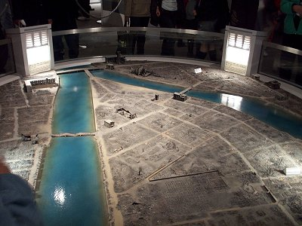
Hiroshima After The Atomic Bomb
Notes:
The model above shows the great destruction at Hiroshima. The entire city was decimated within seconds. It is estimated that 70,000 – 90,000 instantly perished. However, there are also unaccounted deaths due to the massive radiation from the bomb. About 90 percent of the buildings in the city were damaged or completely destroyed.
Picture from - http://www.jfeenstra.com/south_pacific_tour_page_three.htm

Slide 21
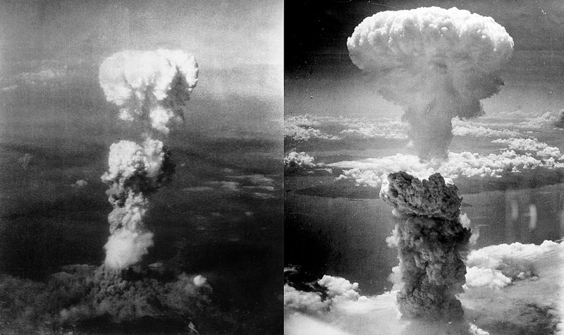
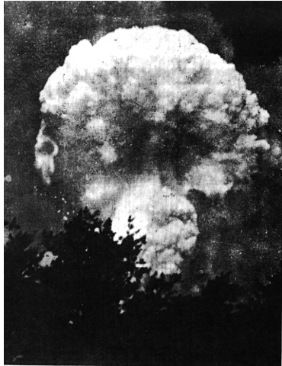

Slide 22
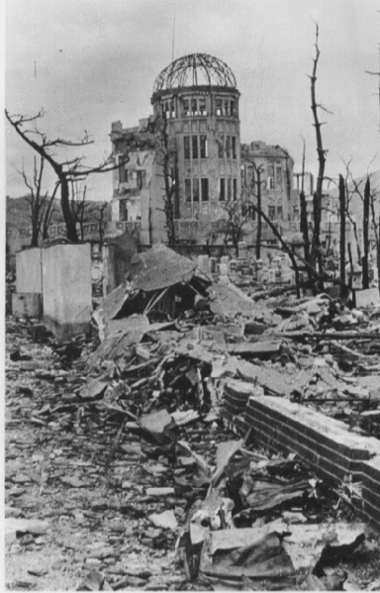
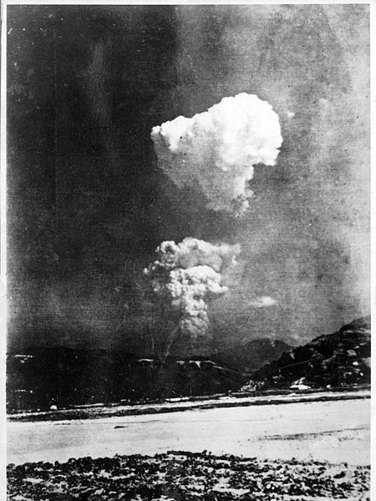

Slide 23
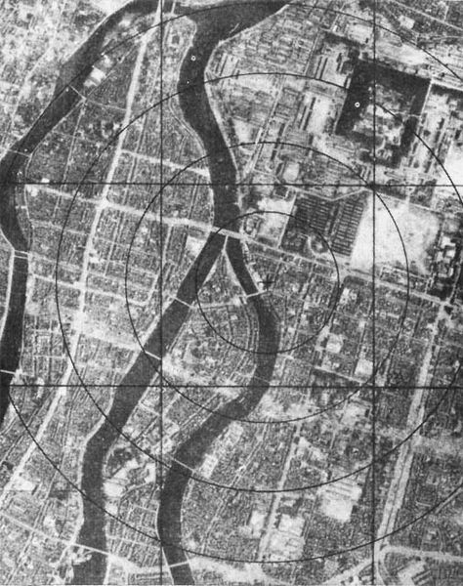
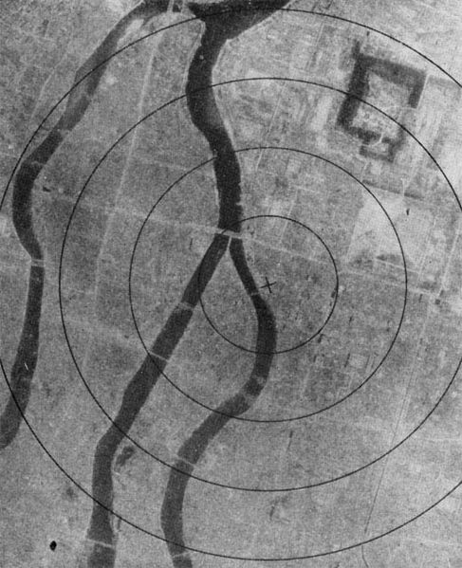

Slide 24
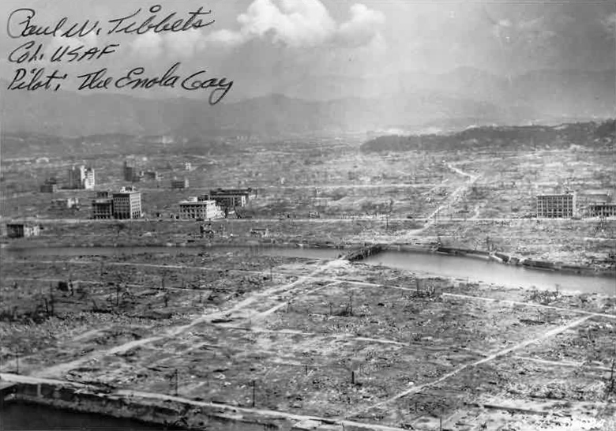

Slide 25
Attacks on Japan, contd
Following the bombing of Hiroshima, Japan was asked to surrender
They refused
August 9 1945 “Fat Man” was dropped on Nagasaki
Killed ~60,000 people
Third bomb was to dropped on August 19
Japan surrenders on August 14, 1945

Slide 26
Formal Warning to Japan
On August 10, 1945 thousands of leaflets were dropped over the city of Nagasaki
The leaflets called for a petition to the Emperor of Japan to stop the war and agree to “accept the consequences and begin the work of building a new, better and peace-loving country.”
Sample Leaflet
Notes:
Now that the first atomic bomb was dropped on Hiroshima, top U.S. leaders felt that Japan deserved a warning before the second bomb was dropped. Thousands of leaflets were dropped on every major city in Japan. They used Hiroshima as an example of the destructive power of the US’s new weapon. America urged that Japan “accept the consequences and begin the work of building a new, better and peace-loving country.” Every leaflet concluded by saying in big bold letters, EVACUATE YOUR CITIES. These leaflets were dropped soon after the atomic bomb was dropped on Hiroshima (August 6, 1945).
Picture - www.childrenofthemanhattanproject.org

Slide 27
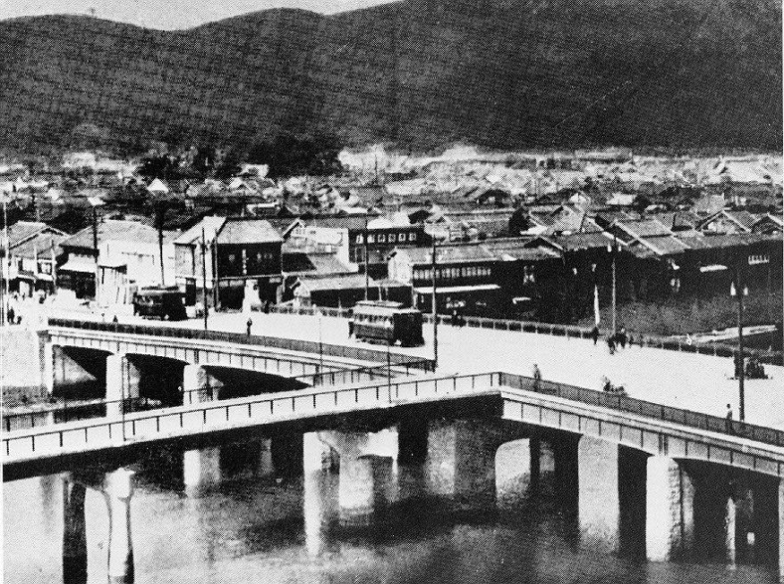
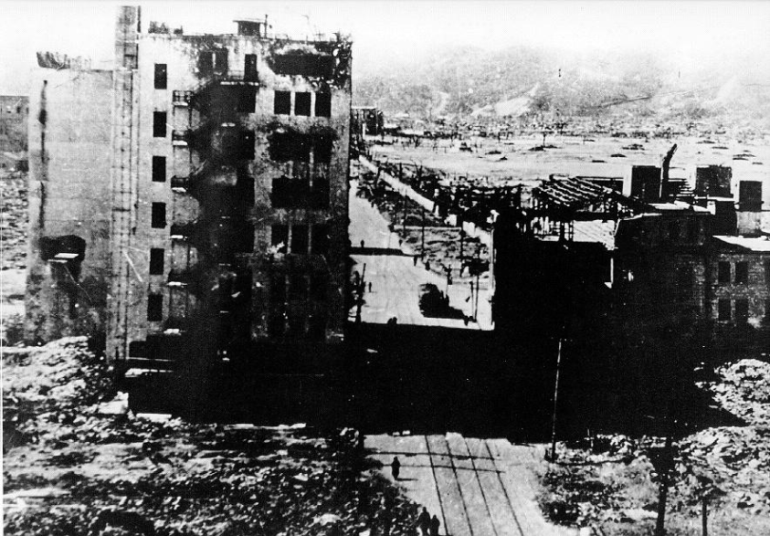
The Bombing: Nagasaki
Before
After
Notes:
In the before and after pictures above, clearly the immediate effects of the bombing are disastrous. On August 1, 1945, high-explosive bombs were dropped on the city. After this bombing, school children were evacuated to rural areas. Five days later, August 6, 1945, Nagasaki experienced its first large scale-bombing. A little north of Nagasaki was a camp holding British POW’s. The atomic bomb saved their lives because they were working underground in the coal mines while the atomic bombs were dropped.
Picture from - http://www2.tcaps.net/ejh/Cooper-Abomb/THE%20TASK_files/image003.gif

Slide 29
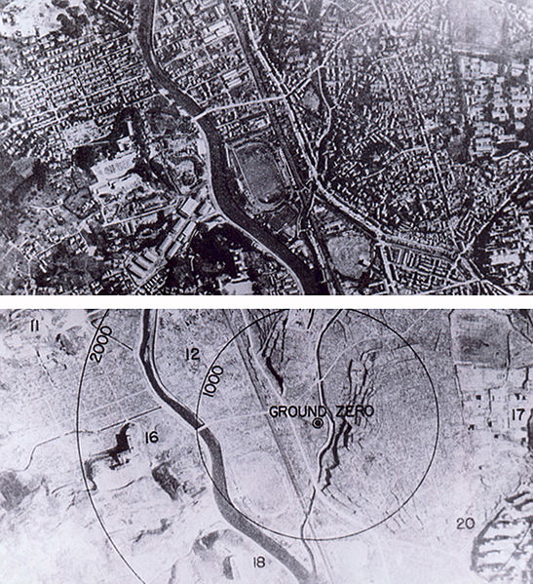

Slide 30
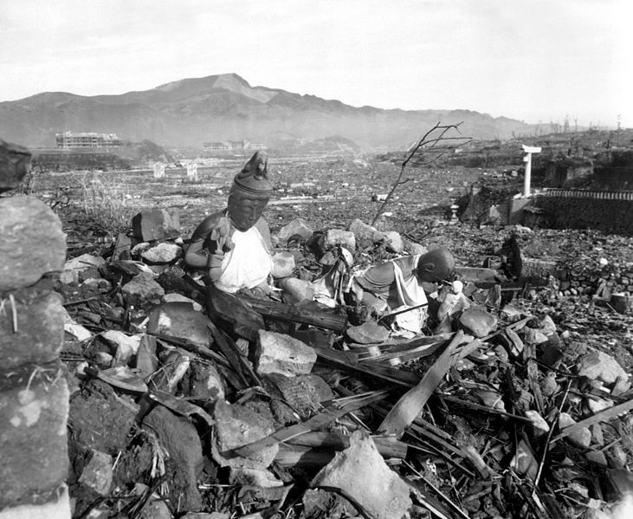

Slide 31
Homework for Monday
Read the “Key Debate” reading
Answer the following questions in complete paragraphs:
Why did President Truman decide to use the atomic bomb?
Do you agree with the Orthodox View or the Revisionist View? Why?

Slide 32
Orthodox vs. Revisionist
In groups of 4-6, discuss the following:
Do you agree with the orthodox or revisionist view? Explain why, referencing the reading.
What are the strengths of the orthodox view? The weaknesses?
What are the strengths of the revisionist view? The weaknesses?
Each group member needs to voice their opinion.

Slide 33
Extract from Hiroshima Diary, by Michihiko Hachiya
“Hundred of people who were trying to escape to the hills passed our house. The sight of them was almost unbearable. Their faces and hands were burnt and swollen; and great sheets of skin had peeled away from their tissues to hang down like rags or a scarecrow. They moved like a line of ants. All through the night, they went past our house, but this morning they stopped. I found them lying so thick on both sides of the road that it was impossible to pass without stepping on them.”

Slide 34
Excerpt from an interview with an American soldier who fought against the Japanese, from The Good War, by Studs Terkel.
“I was in Hiroshima… [that] I saw deformities that I’d never seen before. I know there are genetic effects that may affect generations of survivors and their children. I’m aware of all this. But I also know that had we landed in Japan, we would have faced greater carnage than Normandy. It would probably have been the most bloody invasion in history. Every Japanese man, woman, and child was ready to defend that land. The only way we took Iwo Jima was because we outnumbered them three to one. Still, they held us at bay as long as they did. We’d had to starve them out, month after month after month. As it was, they were really down to eating grass and bark off trees. So I feel split about Hiroshima. The damn thing probably saved my life.”

Slide 35
Yamaguchi’s Story

